Slide 1
Evaluating Materials
Activity 12
First Activity of Unit B

Slide 2
The Chemistry of Materials

Slide 4
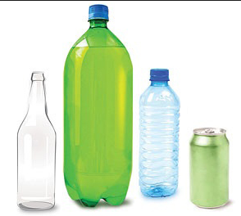
Thinking Space
Which of three materials— aluminum, glass, or plastic—would make the best drink container?

Slide 5
Introduction & Challenge

Slide 6
After reading…
What made you choose as you have: Type of drink, cost of material, appearance, convenience, eco-awareness…?
Property is a quality or trait that characterizes a material or an object.
For example, one property of glass is that it is clear.
One preference described:
Some prefer plastic containers because they are lightweight, can be reclosed, and are “safer” than both glass and aluminum.

Slide 7
Develop a list of factors that could be used to compare one material to another.
Let’s share. Such a list might include:
breakability/safety
cost
convenience (for example, having a re-closable cap)
recyclability
density/weight
With this you can begin your Advantages/Disadvantages Data Table.

Slide 8
A key focus of this unit…
… is selecting a material for a product based on the material’s chemical and physical properties.
You will analyze data and evaluate the advantages and disadvantages of each of three materials.

Slide 9
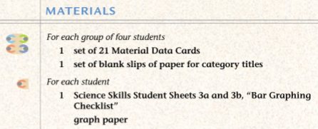

Slide 10
Procedure

Slide 11
Data Table Prepared for you. You are welcome.
-Use your experience and our prior discussion to complete this chart.
-Some data for this chart might be found on the cards.

Slide 12
Don’t forget to make your categories.
Use the note cards.
Consider what seems to be important .
Consider the larger scale of things and long term effects.
Consider businesses and what they need to do to survive as well.
Consider the consumer.

Slide 13
Some Notes
You may need 20–30 minutes to read, discuss, and organize the cards.
Note that in Procedure Step 6, your groups should compare categories with those of another group in the class. They should discuss any differences in the titles you wrote and the way you grouped your cards.
Groups may change their categories or titles if they wish. Sample categories include: percent recycled, cost to produce container, and kcal of energy needed to make one ton.

Slide 14
Let’s compare Advantages and Disadvantages.

Slide 15
Let’s compare categories.
• Cards 1, 10, and 19 state the cost of producing an aluminum can, plastic bottle, and glass bottle.
• Cards 2, 9, and 20 contain multiple pieces of data, but students should graph the amount of kilowatts of energy used to produce a ton of each material.
• Cards 3, 13, and 18 state the amount of waste that will be generated from the production of a ton of material. For graphing purposes students should combine the pollutants and wastes shown on each card.
• Cards 4, 14, and 17 state how many containers can be produced from one ton of material.
• Cards 5, 11, and 15 state the percentage of landfill solid waste that each container type comprises.
• Cards 6, 8, and 21, which have no numerical data, cannot be graphed.
• Cards 7, 12, and 16 state the percentage of each type of container that is recycled every year.

Slide 16
After graphing…
Did these graphs change your mind about which material you think should be used to make the new drink container?
Many are likely to have changed their minds because they based their initial choices factors such as convenience and cost.
During the investigation and graphing activity, considerations of reuse, recycling, and energy costs provided additional evidence to consider.
Note that incorporating more information can be helpful in the decision making process.
Let’s go onto Analysis Question 1, which asks you to identify the most important factors in making your decisions.
You need to explain why you consider one type of information to be more important than another.
Is it for personal reasons or the effect on the environment?

Slide 17
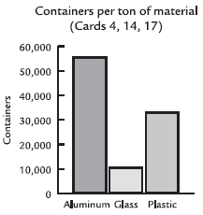
Graphing Data on Aluminum, Plastic, and Glass

Slide 18
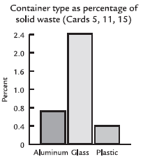
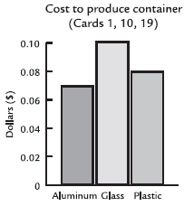
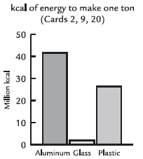
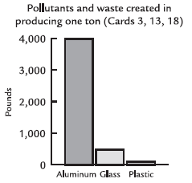

Slide 19
Analysis and Conclusion
Number 5 is Graded!

Slide 20
1. What two types of information do you think are the most important in deciding which material to use to make drink containers? Explain.
Answers will depend on perspectives.
A sample answer follows: The two most important types of information are whether a material is easily recycled and its cost. Recycling cuts down on waste and is good for the environment, and cost is important because the less the container costs to produce, the less you will have to pay for a drink.

Slide 21
2. What additional information would you like to have about these materials? Explain.
Some may report that they would like to know about:
the availability or cost of the materials needed to make the containers;
how wastes resulting from production are disposed of and how this affects the environment;
and how much of each material is produced each year.
They may also be interested in what people prefer.
Important in a correct answer is your reasons for wanting this additional information, such as wanting to find a way to make the product more environmentally friendly and require less energy to produce, or to provide what consumers prefer to buy.

Slide 22
3. Based on your information in your data table, which material is the best for making a drink container, from the viewpoint of each person listed below? Explain your answer for each of these people and support it with evidence from the activity.
a. a consumer concerned with cost and convenience
One possible answer:
The best material from a consumer’s point of view would probably be plastic. If a plastic bottle is dropped, it does not break. Plastic can be reclosed, so if the drink is not all used in one day, it can be kept for another time. Plastic is very cheap to produce, so it does not add much additional cost to the drink.

Slide 23
3b. an environmentalist concerned with energy usage, litter, and problems with a bottle’s impact on the environment
The best material from an environmentalist’s point of view would probably be aluminum. If people recycle aluminum cans, they can get quite a bit of money back. Therefore, they tend to recycle them instead of just littering. This is better for the environment because it means less garbage around and the need for less raw materials to make new cans.
This was just one possible answer.

Slide 24
c. a recycling-center owner who must handle all of the containers turned in for recycling
The recycling-center owner would probably prefer aluminum because he can get more money for scrap aluminum than he can for glass or plastic. Aluminum cans can be smashed down a lot, so a lot of cans do not take up much space, so he would need less room to store the scrap aluminum from the cans until he could sell it for a profit.

Slide 25
4. Did the graphs of the data help you make a decision about the advantages and disadvantages of each material? Explain.
Many will say yes because it was easier to see the differences and to compare the three materials in graph form.
Others may indicated that the same information in the table, would have worked just as well for evaluation purposes.

Slide 26
The Graded One!!!!
5. [ET ASSESSMENT]
What do you think is the best material to use to make drink containers?
Write a letter or prepare a presentation to the president of the drink company describing your recommendation.
Support your answer with evidence and identify the trade-offs of your decision.

