Slide 1
Types of Hazards
Activity 2

Slide 2
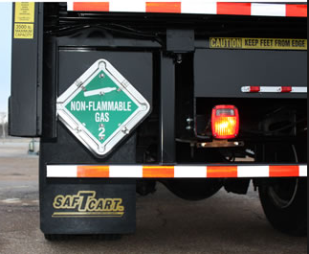
Let’s Read…

Slide 3
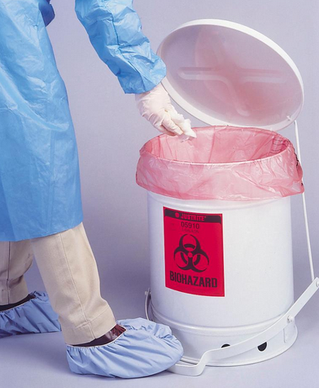
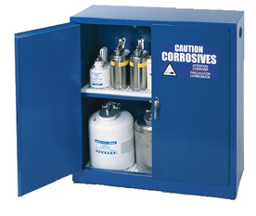
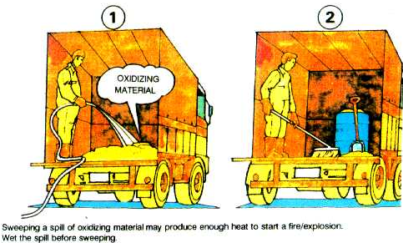
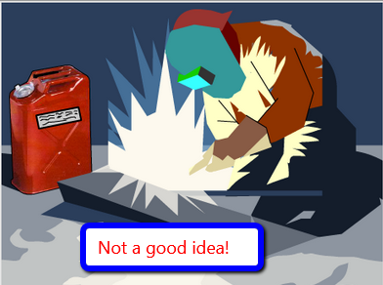
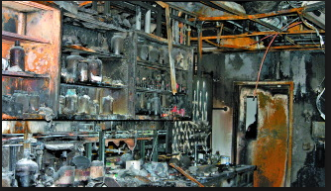
Let’s look…what do you know about each?

Slide 4
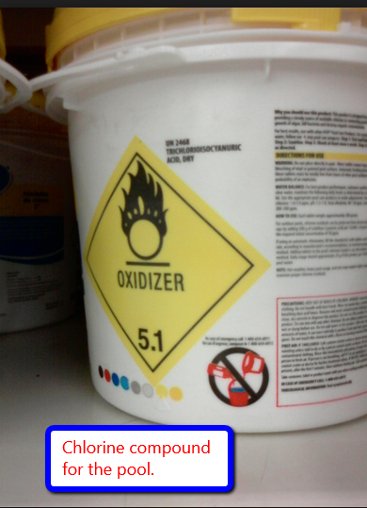
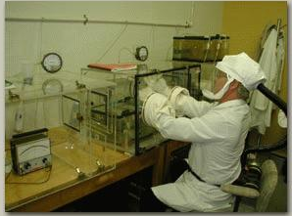
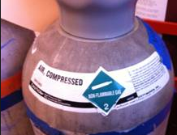
Just a few more…

Slide 5
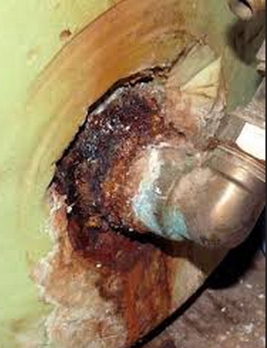
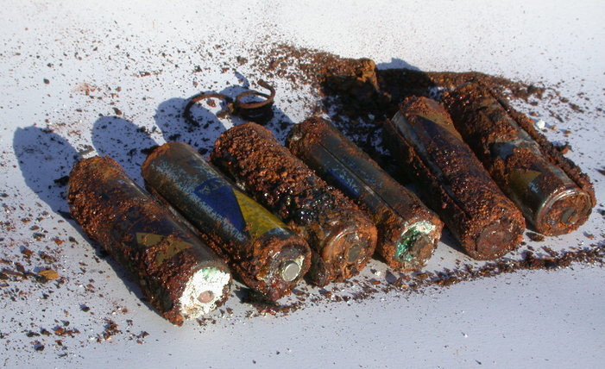
What is the meaning of “Corrosive”?
A substance is corrosive if it reacts with a solid material.
It causes damage to metal or other materials through a chemical process.

Slide 6
Demonstration of Corrosion
We have four aluminum washers in a beaker with approximately 4-mL of copper chloride solution.
And four aluminum washers in a beaker with 4mL of ethanol
And another four washers in a third beaker with 4-mL of water.
Let’s label the containers with the name of the solutions. This is important!
What do you observe in each beaker? Record .

Slide 7
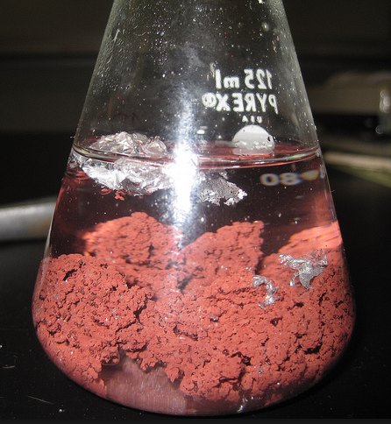
_{First beaker}
Al in CuCl₂

Slide 8
What did you observe in the beakers?
Bubbles appeared
Copper formed as the aluminum metal and copper chloride in the solution react.
The copper chloride solution is corroding the aluminum washer.
However, in contrast, there is no evidence of a chemical reaction (in this case corrosion) in the container with the water or ethanol.

Slide 9
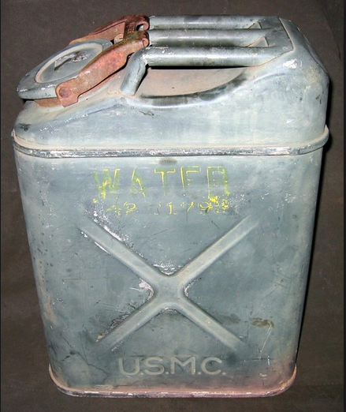
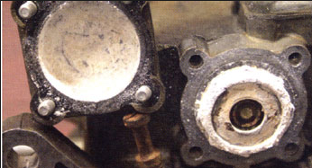
Second and Third Beakers
Ethanol by itself is corrosive to components made of Aluminum and Zinc, like carburetors… but it will take time.
Aluminum will corrode in water in time.

Slide 10
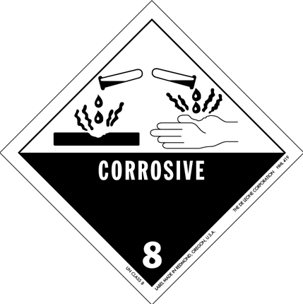
Let’s dispose of this…
What safety precautions should you follow if working with a corrosive liquid?
wear goggles, aprons, gloves,
working through procedures in ways that minimize spills, and contact of solutions with skin or clothing

